Slide 1

Natural Language Processing Project on Yahoo Finance News
Researcher:
Silver, Chan Chung Hei

Slide 2
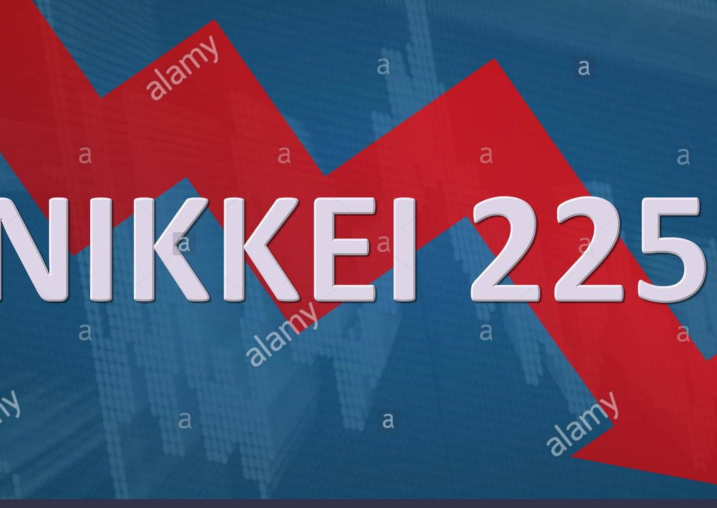
Table of Content
Objectives
News Overview
General Processing
Feature Engineering
Machine Learning
Conclusion

Slide 3

Objectives
Examine the effectiveness of Natural Language Processing (NLP) on financial news
Measure the portion of variability of personal valence towards news explained by variability of valence generated by large language models (LLM) and additional factors
Motivated by the news headline classification experiment mentioned in ‘Natural Language Processing of Financial News’ (M. Berkan Sesen, Yazann Romahi and Victor Li)

Slide 4

News 1 Overview
Title: BlackRock, Man Group Reveal Big Japan Bets Before BOJ Decision
BlackRock and Man Group bullish on Japanese stocks, urging increased investments.
Anticipation rises for a potential Bank of Japan (BOJ) interest rate hike.
Money managers diversify portfolios with short positions on Japanese government debt.
Yen's weakening trend prompts reconsideration, with bets on potential appreciation.
Investors monitor market dynamics amid speculation over BOJ's monetary policy shift.
BlackRock, Man Group Reveal Big Japan Bets Before BOJ Decision (yahoo.com)

Slide 5
News 2 Overview
Title: In the Ukraine war, totalitarianism is beating capitalism
Russia's invasion of Ukraine initially met with Western resistance.
Russia has shown resilience despite economic sanctions.
Energy exports remain strong, offsetting economic challenges.
Russia formed alliances with North Korea, Iran, and China for support.
US aid to Ukraine faces obstacles, reflecting wavering Western resolve.
Uncertain end to the war, with Russia aiming for major gains in 2025
https://finance.yahoo.com/news/in-the-ukraine-war-totalitarianism-is-beating-capitalism-184721301.html.

Slide 6
News 3 Overview
Title: Funds That Have Dodged China’s Stock Rout Say It’s Time to Buy
Skagen AS and Boston Partners have turned bullish on Chinese equities, citing cheap valuations, priced-in risks, and improved earnings.
Skagen AS increased exposure to mainland China and Hong Kong stocks, while Boston Partners doubled its holdings.
Market rebound evident with CSI 300 Index up 5% this year; global investors becoming net buyers, signaling potential sustained rally.
Growing investor confidence backed by improving fundamentals and valuations, presenting opportunities amidst market challenges.
Funds That Have Dodged China’s Stock Rout Say It’s Time to Buy (yahoo.com)

Slide 7

Step 1: General Preprocessing

Slide 8

Elements
Sentiment Analysis (whole text)
Word Cloud
Tokenization
Named Entity Recognition
Stop Words
Lemmatization
Part-of-speech (POS) Tagging

Slide 9
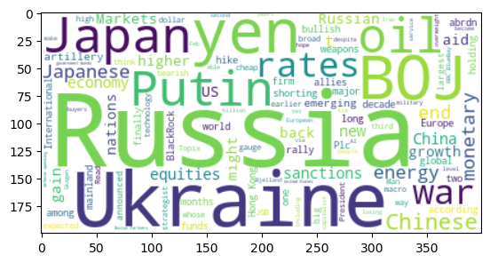
Word Cloud (after stop word removal)

Slide 10
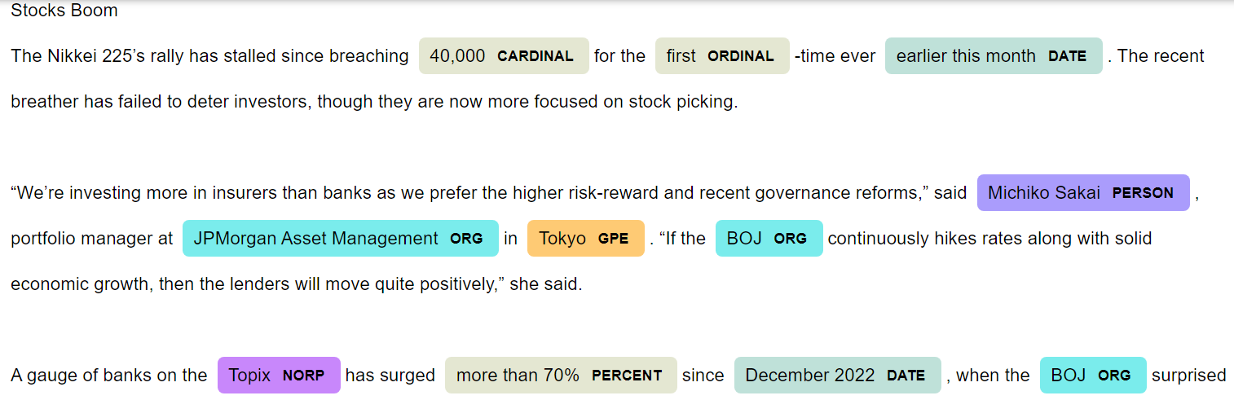
Named Entity Recognition

Slide 11
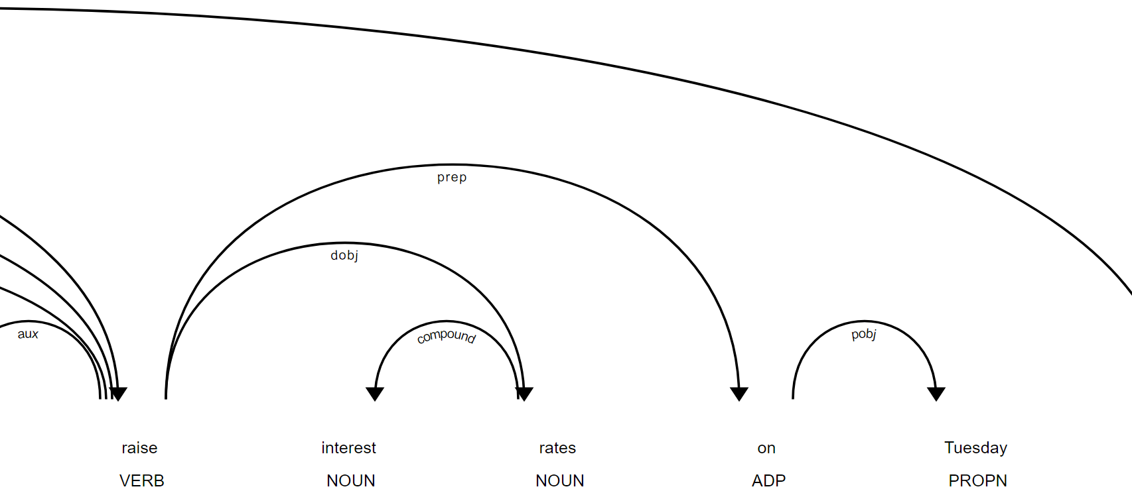
Part-of-speech (POS) Tagging (dependency tree)

Slide 12
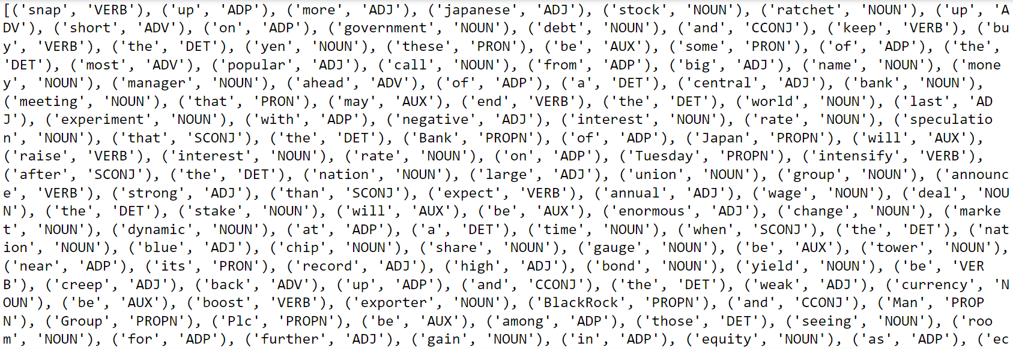
Part-of-speech (POS) Tagging (after lemmatization)

Slide 13

Step 2: Feature Engineering

Slide 14

Elements
Corpus Creation
Bag-of-Words (BoW)
Term Frequency-Inverse Document Frequency (TF-IDF)
Sentence Similarities (for each sentence with the rest of the document)
Sentiment Analysis (sentences)

Slide 15
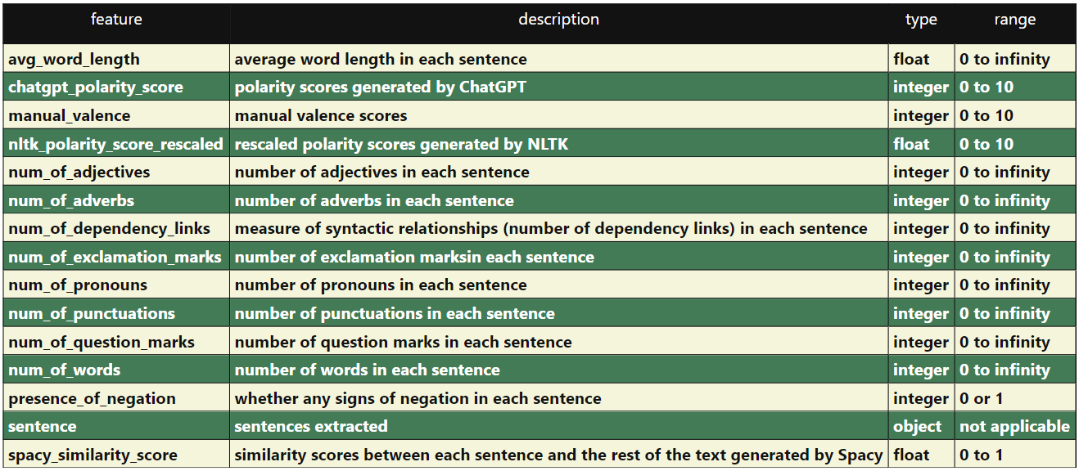
Dataset Variables
Number of columns: 15
Number of rows: 124
Number of missing values: 0

Slide 16
Task
Dependent variable: manual valence
Independent variable: all other features (except sentence)

Slide 17
Hypothesis
ChatGPT polarity scores is the most highly correlated independent variable with manual valence, followed by NLTK polarity score.
Double negations are infrequent in the news.
Correlation within valence and polarity scores do not significantly affect the classification results.

Slide 18



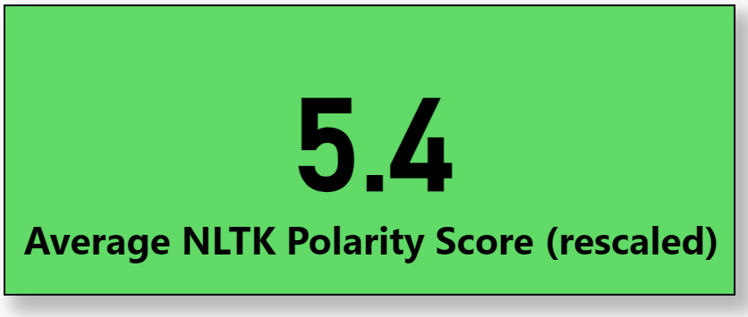
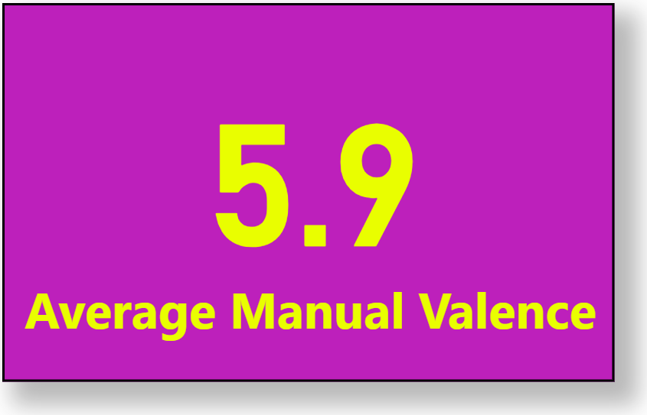
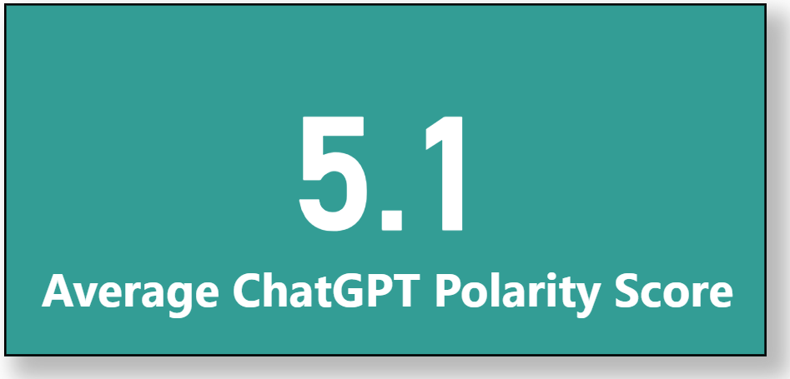
Aggregated Values for Sentence Valence

Slide 19

Step 3: Machine Learning

Slide 20
Elements
Dimensionality Reduction
Exploratory Data Analysis (EDA)
Supervised Learning
Hyperparameter Tuning
Deep Learning

Slide 21
Dimensionality Reduction
Drop the categorical variable (‘sentence’)
Dataset
(15 columns)
Variance Threshold
=0.5
Dataset
(8 columns)

Slide 22
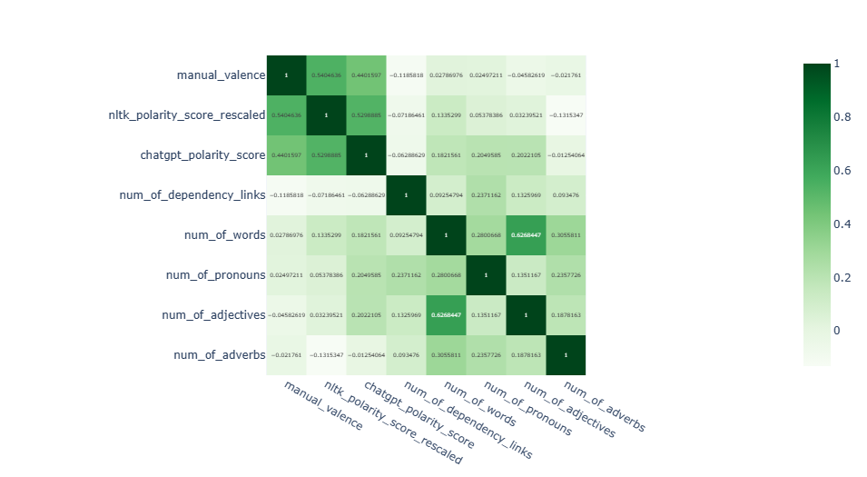
Exploratory Data Analysis (EDA)

Slide 23
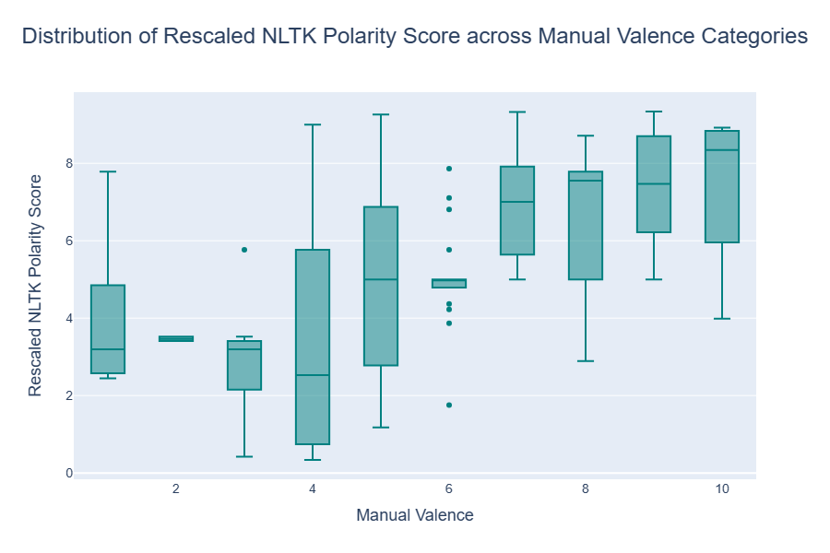

Exploratory Data Analysis (EDA)

Slide 24
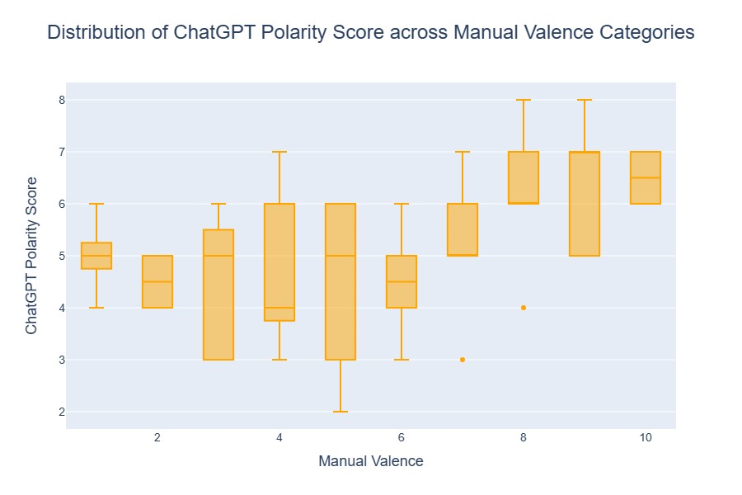
Exploratory Data Analysis (EDA)

Slide 25
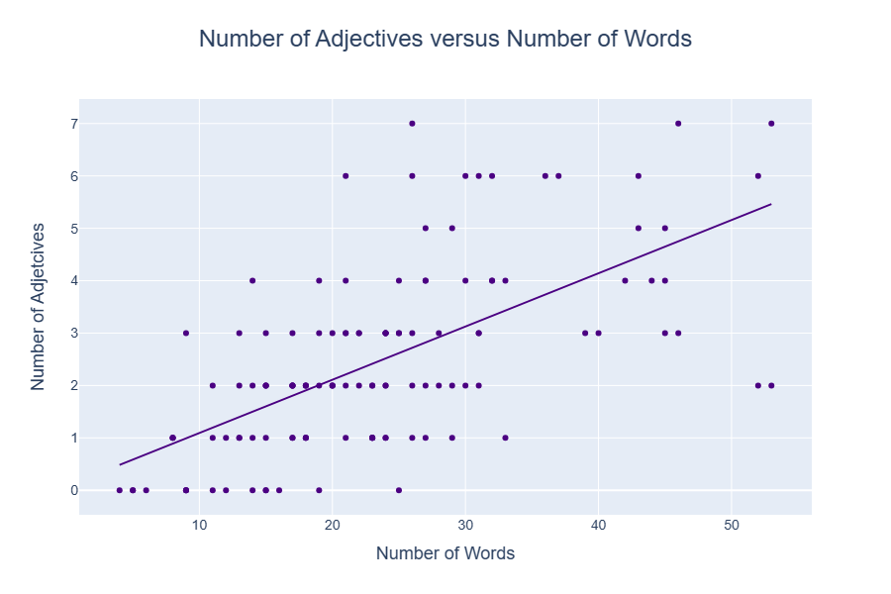

Exploratory Data Analysis (EDA)

Slide 26
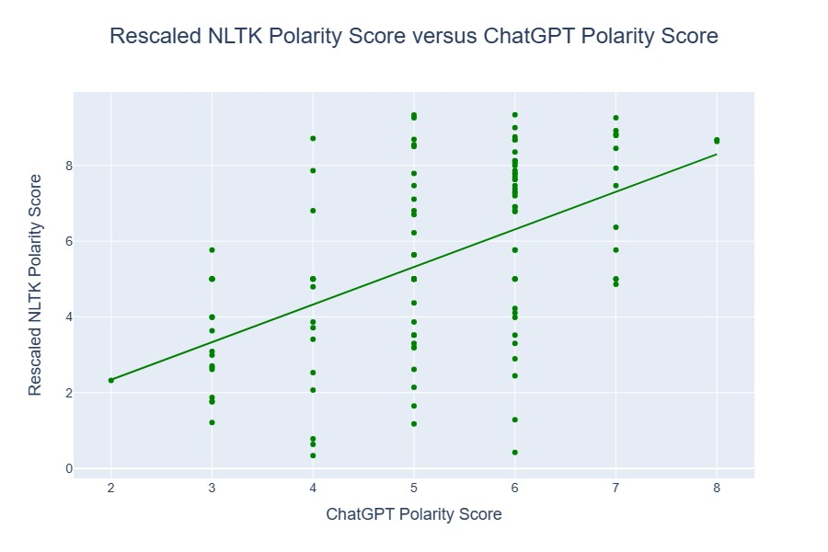
Exploratory Data Analysis (EDA)

Slide 27
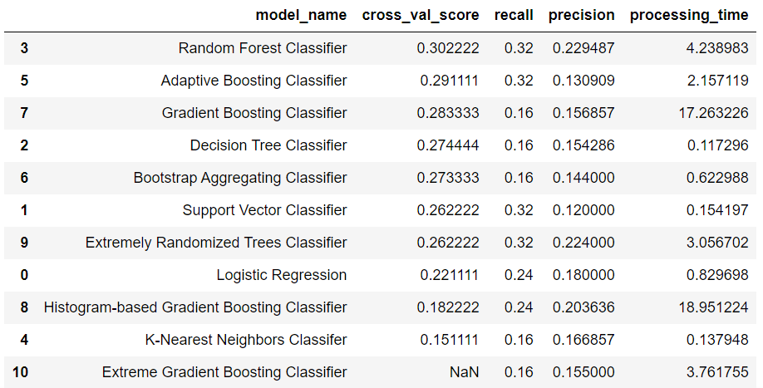
Model Evaluation (unscaled Xs and y)

Slide 28
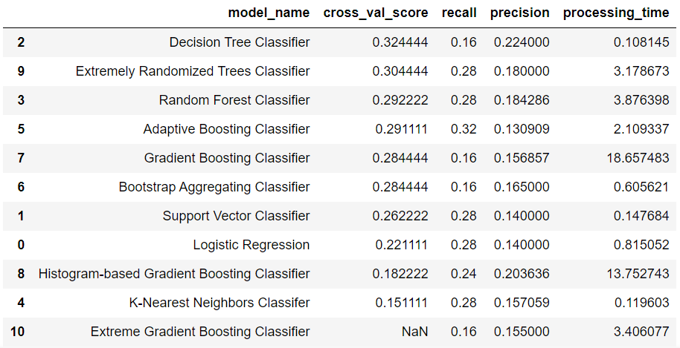
Model Evaluation (scaled Xs and unscaled y)

Slide 29
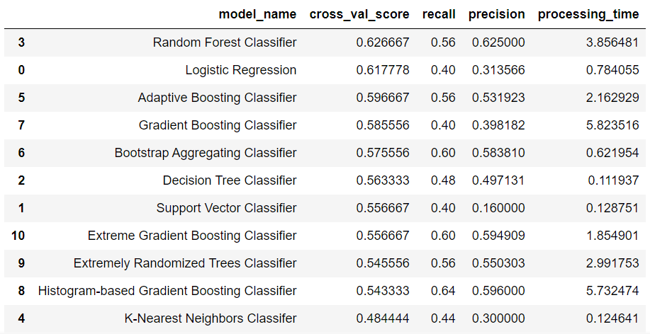
Model Evaluation (unscaled Xs and scaled y)

Slide 30
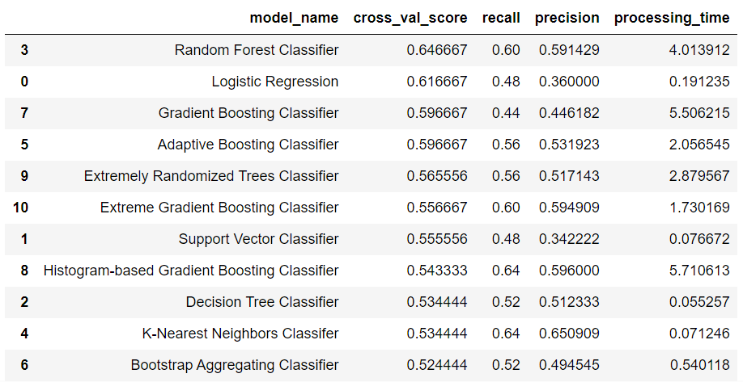
Model Evaluation (scaled Xs and y)

Slide 31
Hyperparameter Tuning (scaled Xs and y)
Random Forest Classifier (by Bayesian optimization)
Significant improvement in cross-validation score
~0.647
+0.030
~0.677
Logistic Regression (by Grid Search)
No improvement in cross-validation score
~0.617
+0
~0.617

Slide 32
Ensemble Method (scaled Xs and y)
Great improvement in cross-validation score
Same as that of the tuned Random Forest Classifier
May include neural networks if possible
Layer 1
Tuned Random Forest Classifier + Tuned Logistic Regression +
Support Vector Classifier +
K-Nearest Neighbors Classifier + Adaptive Boosting Regressor
Meta Classifier
Tuned Random Forest Classifier
Layer 2
Tuned Random Forest Classifier + Tuned Logistic Regression +
Support Vector Classifier +
K-Nearest Neighbors Classifier + Adaptive Boosting Regressor
Meta Classifier
Tuned Random Forest Classifier
Meta Classifier
Tuned Logistic Regression

Slide 33
Deep Learning (unscaled Xs and y)
Keras Sequential model
Low accuracy

Slide 34

Conclusion

Slide 35
Summary of Results
ChatGPT performs not as satisfying as NLTK in generating polarity scores.
Model accuracy of broad valence (+ve/-ve/netual) is far much higher than precise accuracy.
Tuned Random Forest Classifier is the best model at this point.
Complex models generally perform less well (e.g., neural network, Extreme Gradient Boosting Classifier)
Too high accuracy is unnecessary.

Slide 36
Limitations
My manual valence labelling is labour intensive and possibly largely difference from results of the professionals.
Sample size bias (class imbalance, and insufficient neutral and negative class)

Slide 37
To Sum Up…
Application of Natural Language Processing on finance is novel and requires further research.
Named Entity Recognition and polarity scores by Large Language Models (LLMs) are the most convenient tools available for financial news processing.

